Slide 1

The National University of Computer and Emerging Sciences
Recurrent Neural Networks
Deep Learning for Perception
Dr. Akhtar Jamil
Department of Computer Science

Slide 2
Goals
Today’s Lecture
Recurrent Neural Networks
Long-Short Term Memory (LSTM)
Gated Recurrent Units (GRU)

Slide 3
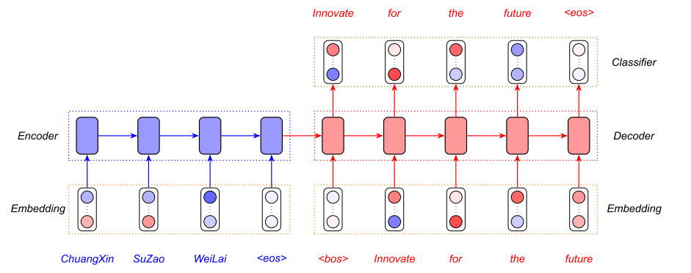
Motivation
Machine Translation
https://www.analyticsvidhya.com/

Slide 4
Recurrent Neural Networks
Recurrent Neural Network is a type of artificial deep learning neural network designed to process sequential data and recognize patterns
The RNNs can remember the input
Internal memory.
This gives RNNs the ability to remember the history of the input data.
May help better predictions

Slide 5
Recurrent Neural Networks
RNN is considered to be one of the most robust neural network algorithms.
This is a powerful algorithm
Became popular due to invention of long short-term memory(LSTM).
Remembers longer history
RNNs can remember some key information about the past input
More accurate in predicting what is coming next.

Slide 6
Recurrent neural networks
RNNs are very powerful, because they combine two properties:
Hidden state allows them to store a lot of information about the past efficiently.
Architecture that allows them to update their hidden state in complicated ways.
With enough neurons and time, RNNs can compute the desired outputs.
time →
output
output
output
hidden
hidden
hidden
input
input
input

Slide 7
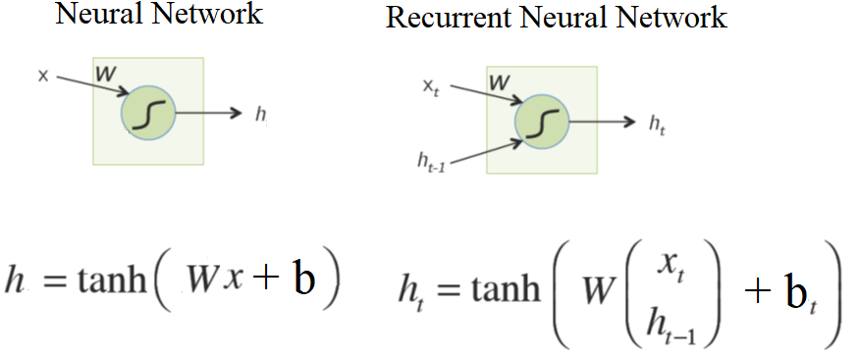
Simple Neuron in an RNN
y
RNN
x

Slide 8
Applications
Predictive Analytics: Stock Price Forecasting
Anomaly Detection : Ad Fraud, Spam Detection
Sentiment Analysis
Semantic Search
Speech-to-text, Speech Translation or Recognition
RNN Text Generation - Text Summarization, Report Generation
Image Captioning
Music generation

Slide 9

Example: Music Generation

Slide 10

An Example
All previous examples were generated blindly by a recurrent neural network.

Slide 11
Training RNN
We can use backpropagation to train RNN
Forward Phase
Backward Phase
Weight Updating

Slide 12
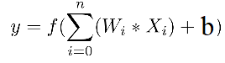
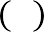
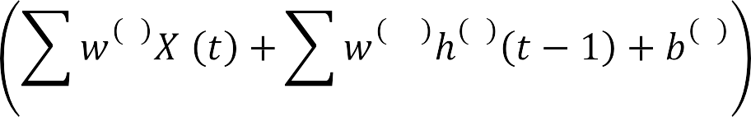
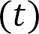
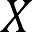
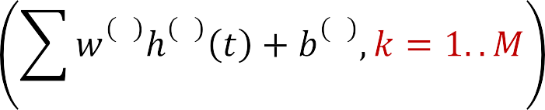
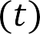
Training RNN: Forward Pass
Current weights
Recurrent weights
h₀ = Initialize
(1)
1
1
ji
11 1
ji
1
i
1
j
i
i
j
j
2 1
jk j
2
k
2
j
Note superscript in indexing, which indicates layer of network from which inputs are obtained
Assuming vector function at output, e.g. softmax
The state node activation, is typically
•
Every neuron also has a bias input

Slide 13
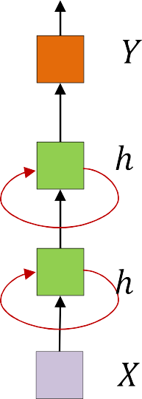
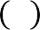



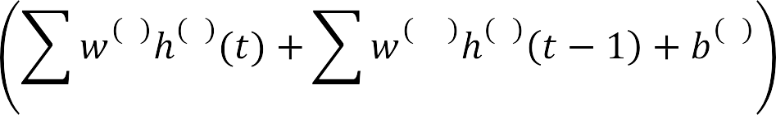



Training RNN: Forward Pass
(2)
1
1
ji
11 1
ji
1
i
1
j
i
i
(1)
j
j
2
2 1
ji j
22 2
ji
2
i
2
i
i
j
j
3 2
jk j
3
k
3
j
Assuming vector function at output, e.g. softmax
The state node activations, are typically
•
Every neuron also has a bias input

Slide 14
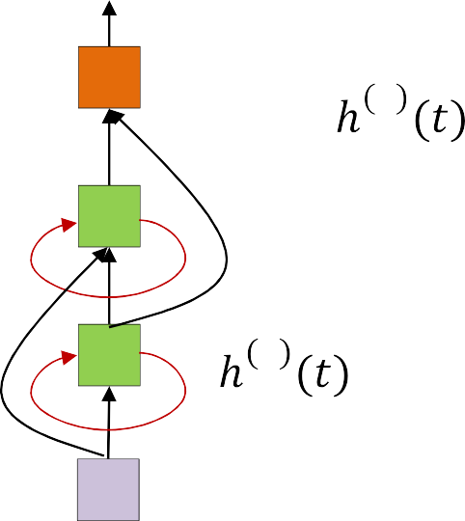
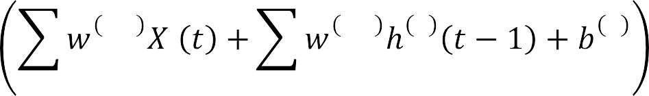
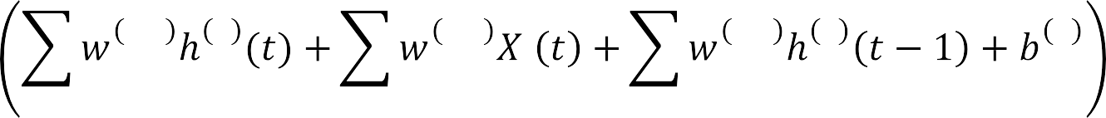
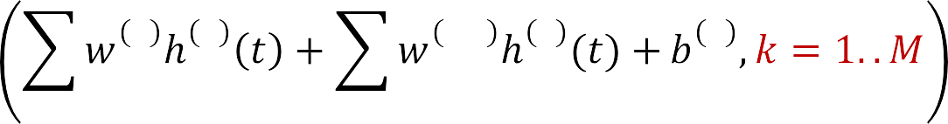

Training RNN: Forward Pass
1
0,1
ji
1,1 1
ii
1
i
1
j
i
i
j
i
2
1,2 1
ji
0,2
ji
2,2 2
ii
2
i
2
j
j
i
i
j
j
i
 |  |  | 2 |  | 2 | 1,3 |  | 1 | 3
i |  | 3 | jk | j |  | jk | j |  | k
j
j

Slide 15
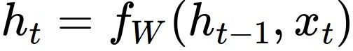
Recurrent Neural Network
We can process a sequence of vectors x by applying a recurrence formula at every time step:
y
RNN
new state old state input vector at
some time step
x
some function
with parameters W
Fei-Fei Li & Justin Johnson & Serena Yeung

Slide 16
Recurrent Neural Network
We can process a sequence of vectors x by applying a recurrence formula at every time step:
y
RNN
x
Notice: the same function and the same set of parameters are used at every time step.
Fei-Fei Li & Justin Johnson & Serena Yeung
Fei-Fei Li & Justin Johnson & Serena Yeung Lecture 10 - May 4, 2017

Slide 17
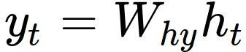
(Vanilla) Recurrent Neural Network
The state consists of a single “hidden” vector h:
y
RNN
x
Fei-Fei Li & Justin Johnson & Serena Yeung
Fei-Fei Li & Justin Johnson & Serena Yeung Lecture 10 - May 4, 2017

Slide 18
RNN: Computational Graph
h₀
f_{W}
h₁
x₁
Fei-Fei Li & Justin Johnson & Serena Yeung
Fei-Fei Li & Justin Johnson & Serena Yeung Lecture 10 - May 4, 2017

Slide 19
RNN: Computational Graph
h₀
f_{W}
h₁
f_{W}
h₂
x₁
x₂
Fei-Fei Li & Justin Johnson & Serena Yeung
Fei-Fei Li & Justin Johnson & Serena Yeung Lecture 10 - May 4, 2017

Slide 20
RNN: Computational Graph
h₀
h₁
h₂
h₃
…
h_{T}
f_{W}
f_{W}
f_{W}
x₁
x₂
x₃
Fei-Fei Li & Justin Johnson & Serena Yeung
Fei-Fei Li & Justin Johnson & Serena Yeung Lecture 10 - May 4, 2017

Slide 21
RNN: Computational Graph
Re-use the same weight matrix at every time-step
h₂
h₃
…
h_{T}
h₀
f_{W}
h₁
f_{W}
f_{W}
x₁
x₂
x₃
W
Fei-Fei Li & Justin Johnson & Serena Yeung
Fei-Fei Li & Justin Johnson & Serena Yeung Lecture 10 - May 4, 2017

Slide 22
RNN: Computational Graph: Many to Many
y₁
y₂
y₃
y_{T}
h₂
h₃
…
h_{T}
h₀
f_{W}
h₁
f_{W}
f_{W}
x₁
x₂
x₃
W
Fei-Fei Li & Justin Johnson & Serena Yeung
Fei-Fei Li & Justin Johnson & Serena Yeung Lecture 10 - May 4, 2017

Slide 23
RNN: Computational Graph: Many to Many
y₁
y₂
y₃
y_{T}
L₁
L₂
L₃
L_{T}
h₂
h₃
…
h_{T}
h₀
f_{W}
h₁
f_{W}
f_{W}
x₁
x₂
x₃
W
Fei-Fei Li & Justin Johnson & Serena Yeung
Fei-Fei Li & Justin Johnson & Serena Yeung Lecture 10 - May 4, 2017

Slide 24
RNN: Computational Graph: Many to Many
L
y₁
y₂
y₃
y_{T}
L₁
L₂
L₃
L_{T}
h₂
h₃
…
h_{T}
h₀
f_{W}
h₁
f_{W}
f_{W}
x₁
x₂
x₃
W
Fei-Fei Li & Justin Johnson & Serena Yeung
Fei-Fei Li & Justin Johnson & Serena Yeung Lecture 10 - May 4, 2017

Slide 25
RNN: Computational Graph: Many to One
y
h₂
h₃
…
h_{T}
h₀
f_{W}
h₁
f_{W}
f_{W}
x₁
x₂
x₃
W
Fei-Fei Li & Justin Johnson & Serena Yeung
Fei-Fei Li & Justin Johnson & Serena Yeung Lecture 10 - May 4, 2017

Slide 26
Training RNN: Backward Pass
Y(0) Y(1) Y(2)
Y(T-2) Y(T-1) Y(T)
^{h}-1
X(0)
X(1)
X(2)
X(T-2)
X(T-1)
X(T)
t
Back propagation through time (BPTT)
Given a collection of sequence inputs
– (𝐗_{i}, 𝐃_{i}), where
– 𝐗_{i} = 𝑋_{i,0}, … , 𝑋_{i,T}
– 𝐃_{i} = 𝐷_{i,0}, … , 𝐷_{i,T}
Train network parameters to minimize the error between the output of the
network _{i i,0 i,T} and the desired outputs
– This is the most generic setting. In other settings we just “remove” some of the input or output entries
70

Slide 27
Backpropagation through time
We can think of the recurrent net as a layered, feed-forward net with shared weights and then train the feed-forward net.
We can also think of this training algorithm in the time domain:
The forward pass builds up a stack of the activities of all the units at each time step.
The backward pass works in reverse direction to compute the error derivatives at each time step.
After the backward pass we add together the derivatives at all the different times for each weight.

Slide 28
Training: Computing gradients
Y(0)
Y(1)
Y(2)
Y(T-2)
Y(T-1)
Y(T)
^{h}-1
X(0)
X(1)
X(2)
X(T-2)
X(T-1)
X(T)
t
For each training input:
Backward pass: Compute gradients via backpropagation
– Back Propagation Through Time

Slide 29
Thank You ☺

